Slide 1

Preparation, Properties N Applications Of Kevlar And Its Structure

Slide 2

Introduction to Kevlar

Slide 3
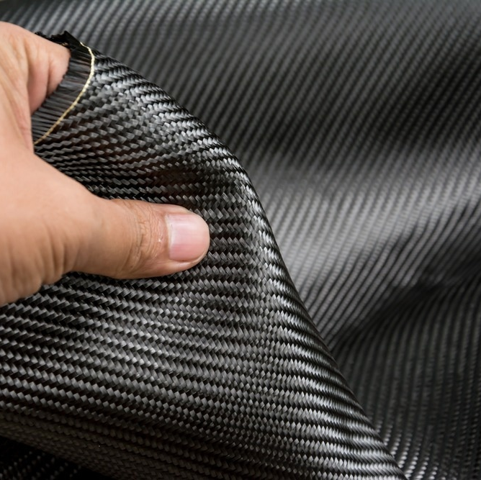
What is Kevlar?
Kevlar is a high-strength synthetic fiber developed by DuPont.
It is a polyamide.
Chemical name is poly-para-phenylene terephthalamide (PPTA) It's known for its outstanding toughness, heat resistance, and lightweight properties.
Commonly used in bulletproof vests, tires, ropes, and more.
Liquid crystalline polymer
Condensation polymer
Thermosetting polymer

Slide 4
Preparation of Kevlar

Slide 5
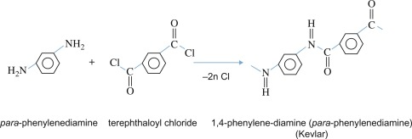
Preparation Process: Polymerization Reaction
List the key raw materials:
p-Phenylenediamine (PPD)
Terephthaloyl chloride (TCl)
By-product formed is HCl
Solvents like N-methylpyrrolidone (NMP) or hexamethylphosphoramide (HMPA) and CaCl2

Slide 6
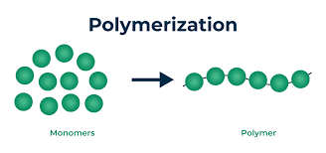
Polymerization Process
Condensation reaction between PPD and TPC.
Formation of polymer chains through amide bonds.

Slide 7
Step 1 – Synthesis of Polymer
Reaction:
PPD reacts with TPC in a solvent.
The reaction produces Kevlar chains and hydrochloric acid as a by-product.
Key Conditions:
Conducted in a controlled environment.
Reaction temperature: ~0°C to prevent side reactions.

Slide 8
Step 2 – Spinning the Fibers
Dissolution:
The polymer is dissolved in concentrated sulfuric acid to produce a viscous spinning solution.
Fiber Formation:
Solution is extruded through spinnerets into an acid bath, forming solid fibers.

Slide 9
Step 3 – Post-Treatment
Washing and Drying:
Fibers are thoroughly washed to remove residual acid and impurities.
Dried under controlled conditions to retain structural integrity.
Heat Treatment:
Enhances crystallinity and orientation of polymer chains, increasing tensile strength.

Slide 10
Properties of Kevlar

Slide 11
Mechanical Properties
High Tensile Strength:
Five times stronger than steel (per unit weight).
Lightweight:
Ideal for applications requiring strength without added bulk.
Flexibility:
Retains strength while being pliable.

Slide 12
Thermal Properties
Heat Resistance:
Decomposes at around 450°C without melting.
Low Thermal Conductivity:
Effective in fire-resistant clothing.

Slide 13
Chemical Properties
Chemical Resistance:
Resists degradation by most chemicals, including acids and alkalis.
Low Reactivity:
Stable under most environmental conditions.

Slide 14
Electrical Properties
Non-Conductive:
Used in electrical insulation.
High Dielectric Strength:
Excellent for high-voltage environments.

Slide 15
Advantages and Limitations
Advantages:
High strength-to-weight ratio
Heat and chemical resistance
Durability
Limitations:
Degradation under UV exposure
Expensive production

Slide 16
Application of Kevlar

Slide 17
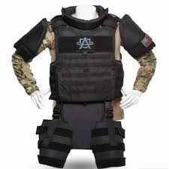
Ballistic Protection
Bulletproof vests
Helmets
Armor for vehicles
Advantages:
Lightweight and portable
High-impact resistance

Slide 18

Aerospace and Automotive
Aerospace: Reinforced parts in airplanes, spacecraft for weight reduction.
Automotive:
Brake pads
Tires
Reinforced car bodies
Benefits: Enhanced safety and fuel efficiency.

Slide 19
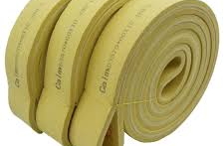
Industrial Uses
Conveyor belts
Ropes and cables (marine and industrial)
Protective clothing for workers (gloves, aprons).
Advantages: Long lifespan, reduced maintenance.

Slide 20

Sports and Recreation
Lightweight canoes and kayaks.
Racing sails.
Protective gear for athletes (helmets, gloves).

Slide 21

Electronics and Telecommunications
Fiber-optic cables.
Reinforcement in smartphone components.

Slide 22
Structure of Kevlar

Slide 23
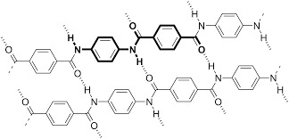
Chemical Structure of Kevlar
Molecular Formula: (C₁₄H₁₀N₂O₂)n
Chemical Name: Poly(paraphenylene terephthalamide)
Key Features:
Kevlar is a polymer with repeating units of aromatic polyamide (aramid).
It has strong amide bonds (-CO-NH-) between benzene rings.

Slide 24
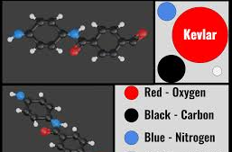
Molecular Structure of Kevlar
Structure Visualization:
Linear chains of aromatic rings linked by amide groups.
The chains are highly oriented, leading to strong intermolecular hydrogen bonding.
Diagram: (Include an illustration of the molecular structure, with labeled amide groups and hydrogen bonds)

Slide 25
Hydrogen Bonding and Its Impact
Hydrogen Bonding:
Kevlar's strength is due to hydrogen bonds between adjacent polymer chains.
These bonds contribute to its high tensile strength and thermal stability.
Key Impact:
High tensile strength (up to 3,620 MPa).
Resistant to abrasion and high temperatures.

Slide 26
Microstructure of Kevlar Fibers
Fiber Alignment:
Kevlar fibers are highly crystalline.
The polymer chains align parallel to the fiber axis, increasing strength.
Properties:
High modulus of elasticity (83 GPa).
Lightweight and flexible.

Slide 27
Comparison with Other Materials
Comparison Table: Kevlar vs. Steel vs. Nylon
Strength-to-weight ratio: Kevlar is 5 times stronger than steel.
Density: Kevlar is lighter than both steel and nylon.
Thermal Resistance: Kevlar withstands temperatures up to 450°C without melting.

Slide 28
Conclusion
Summary:
Kevlar’s unique structure offers exceptional strength and durability.
Widely used in various industries for protective and high-performance applications.
Future Outlook:
Potential innovations in lighter and more cost-effective aramid fibers.

Slide 29

Thank you
Credits:
Alen Roy Thomas
Agatha S Rajesh
Amana Shema S J

